Slide 1

node.js
VAVJS
FIIT 2018

Slide 2
What is node.js
Čo je node.js:
Načo je (bol vymyslený):
Server Side JavaScript
Built on Google‘s V8
Evented, non-blocking I/O.
Module System (CommonJS and ES)
To provide a purely evented, non-blocking infrastructure to script highly concurrent programs (web servers,...)
The API should should be fammiliar to client side JS programmers and old school UNIX hackers
Ryan Dahl: Introduction to Node.js, https://www.youtube.com/watch?v=M-sc73Y-zQA

Slide 3
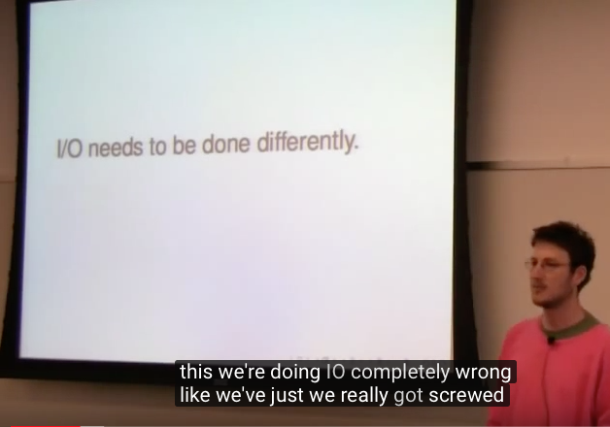
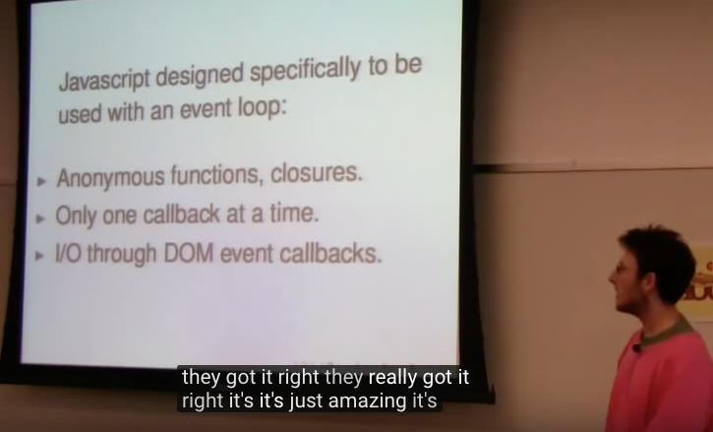
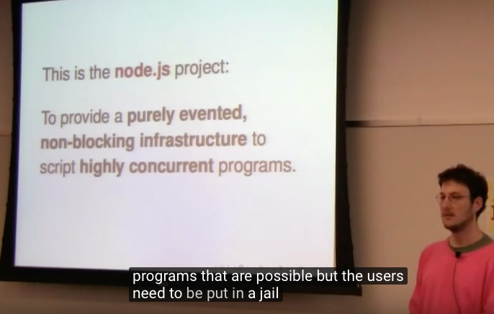
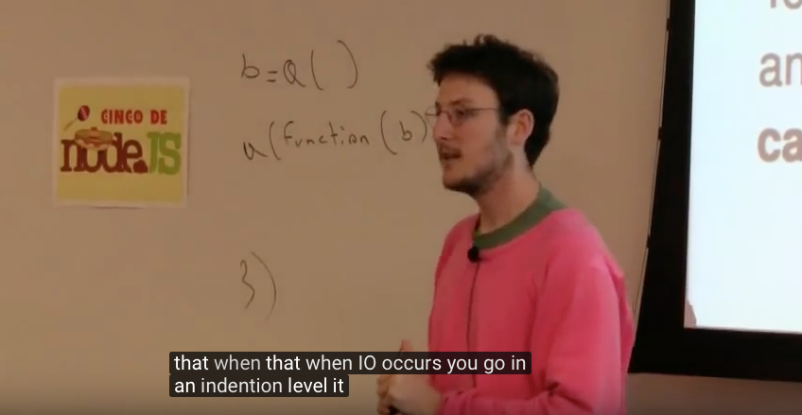
What is node.js (in 4 pictures)
Ryan Dahl: Introduction to Node.js, https://www.youtube.com/watch?v=M-sc73Y-zQA

Slide 4
What is node.js
Prečo bol vymyslený:
Design Goals (original R.D.)
IO needs to be done differently,
threaded concurrency is a leaky abstraction
Why is not everyone using event loops, callbacks and non blocking IO ?
No function should direct perform IO
To receive info from disk, net or another process, there must be callback
Stream everything, never force buffering of data
Have build-in support for most important protocols TCP, DNS, HTTP
Prečo Java Script
Anonymous functions, closures
Ony one callback at a time
DOM Events („I/O“ in browser)
Ryan Dahl: Introduction to Node.js, https://www.youtube.com/watch?v=M-sc73Y-zQA

Slide 5
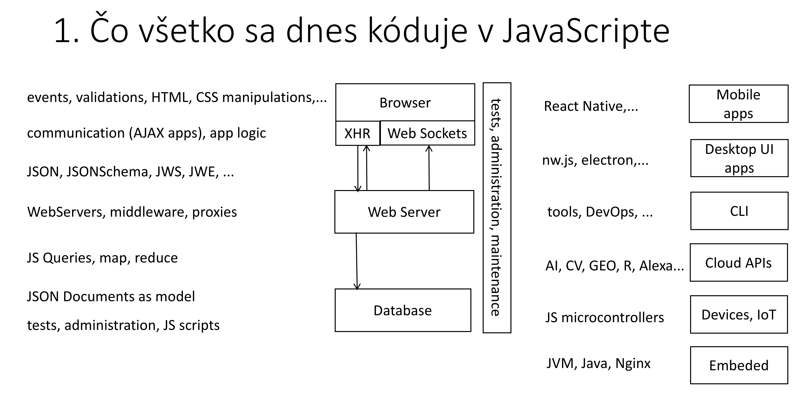
What is node.js
MDN Definition
Prax
Node (or more formally Node.js) is an open-source, cross-platform, runtime environment that allows developers to create all kinds of server-side tools and applications in JavaScript.
The runtime is intended for use outside of a browser context (i.e. running directly on a computer or server OS). As such, the environment omits browser-specific JavaScript APIs and adds support for more traditional OS APIs including HTTP and file system libraries
open source: https://github.com/nodejs/node
cross platform: Linux, OSX, Windows, SunOS AIX on Power Series, Linux on Power Series, Linux on System z
all kinds:

Slide 6
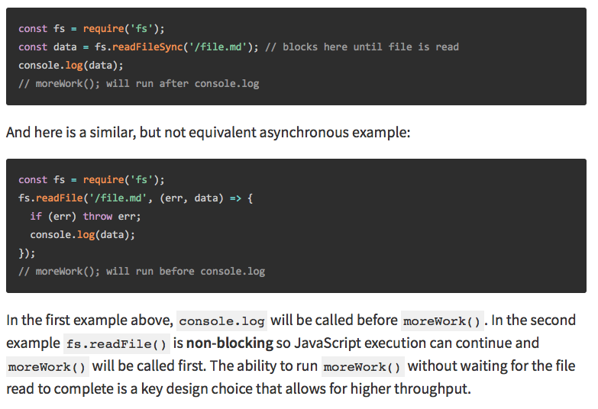
blocking vs non blocking
https://nodejs.org/en/docs/guides/blocking-vs-non-blocking/

Slide 7
node.js platform
Pieces of puzzle

Slide 8
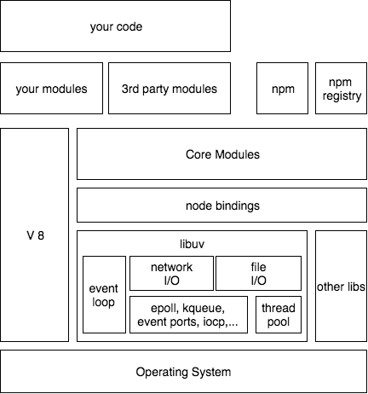
node.js platform
your code is:
written in JavaScript language
one starting file (index.js, server.js, app.js)
Run by V8 engine

Slide 9
node.js platform
V8 is Google’s
open source
high-performance JavaScript engine
written in C++
used in Google Chrome, node.js and others
V8 Design Elements
just-in-time (JIT) compilation
Fast Property Access
Dynamic Machine Code Generation
Efficient Garbage Collection
https://github.com/v8/v8/wiki/Design-Elements, https://v8project.blogspot.com/2016/08/firing-up-ignition-interpreter.html

Slide 10
node.js platform
your code is using core modules
File I/O
Net I/O, HTTP, TCP,…
Terminal I/O
Other things
remember: JavaScript language has no I/O API

Slide 11
node.js platform
I/O in core modules is implemented in libuv
libuv is a multi-platform support library with a focus on asynchronous I/O. It was primarily developed for use by Node.js, but it’s also used by Luvit, Julia, pyuv, and others.

Slide 12
node.js platform – libuv, event loop
libuv
I/O exposed as single threaded event loop
uses available OS mechanisms for evented IO
blocking OPs performed in thread pool (internally)

Slide 13
node.js platform
node bindings provide access to C binaries from JavaScript
libuv
other libs
http-parser
c-ares
OpenSSL
zlib

Slide 14
node.js platform
your code may use 3rd party modules
packages installed by npm program
downloaded from npm registry

Slide 15
node.js platform
YOUR CODE shell be de-composed to modules as well
CommonJS
ES modules

Slide 16
node.js platform
YOUR CODE can be published
to npm registry
using npm
you can reuse
others can reuse

Slide 17
Core Modules and APIs

Slide 18
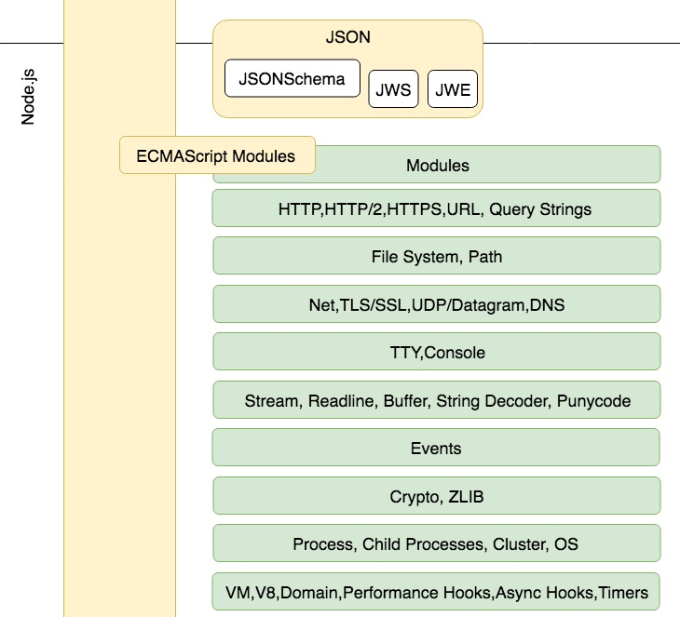
Core Modules and APIs
38 modules
3 deprecated
5 experimental
30 modules
http
filesystem
streams
events
...

Slide 19
Core Modules and APIs
Functionality:
networking
http
tcp,ipc,udp,dns
filesystem
processes
Concepts:
events
stream
buffer
Support:
functionality
zlib, crypto, ...
code and runtime
module, .. inspector
url
http
module
query_string
http2
vm
https
events
assert
crypto
util
tls
net
timers
dgram
repl
zlib
dns
buffer
async_hooks
path
fs
stream
string_decoder
perf_hooks
readline
trace_events
os
child_process
inspector
console
tty
process
cluster
worker_threads

Slide 20
Event loop
How does it work
Single threaded and concurrent ?

Slide 21

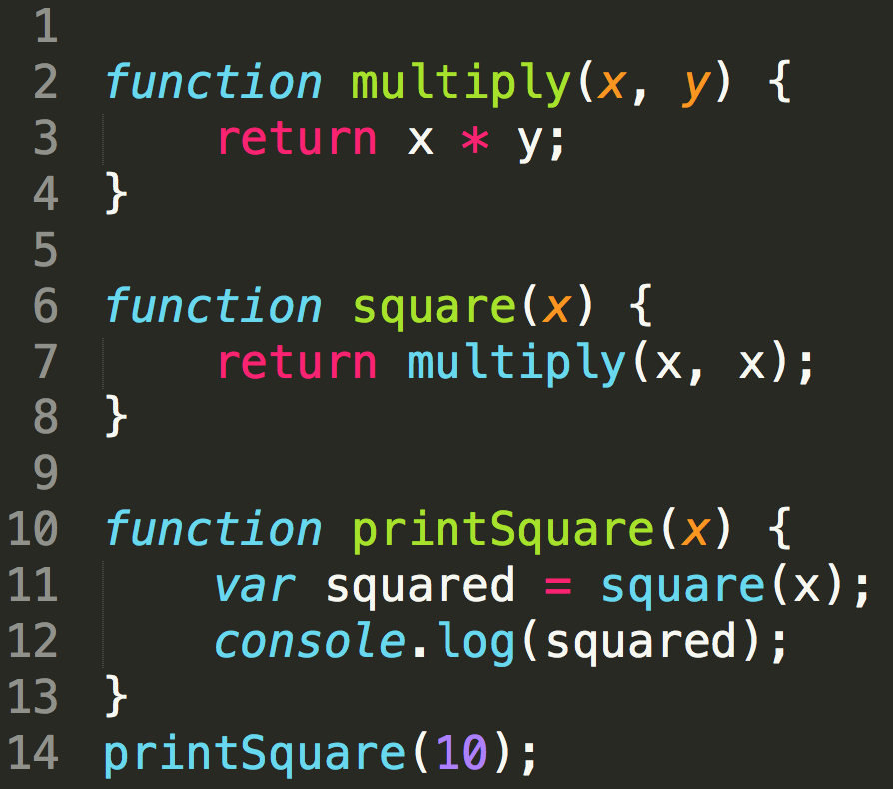
Stack
Your code
V8 – stack
lib-uv
multiply
square
console.log
Each function call is pushed on the stack
printSquare
main

Slide 22
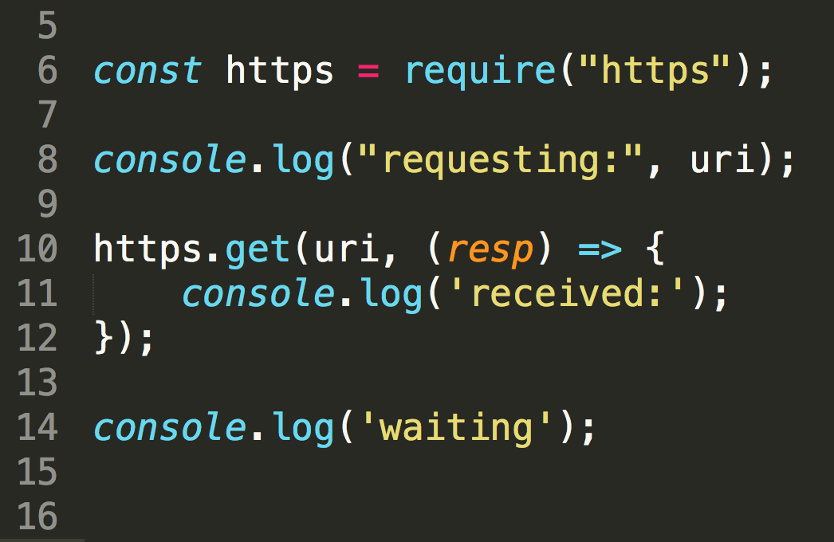

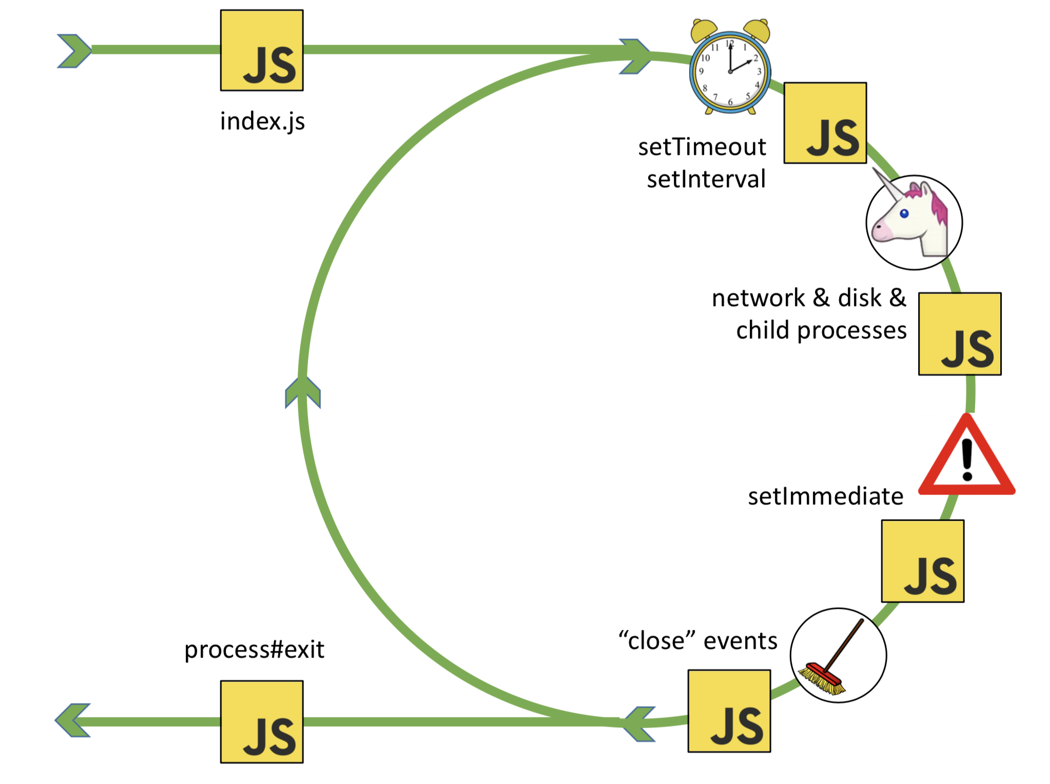
Event Loop
Your code
V8 – stack
lib
http.get(. )
(resp)=>{}
queue
Callbacks to async function get queued and are moved to stack for execution by event loop when stack is empty
(resp)=>{}
http.get
require
console.log
(resp)=>()
main

Slide 23
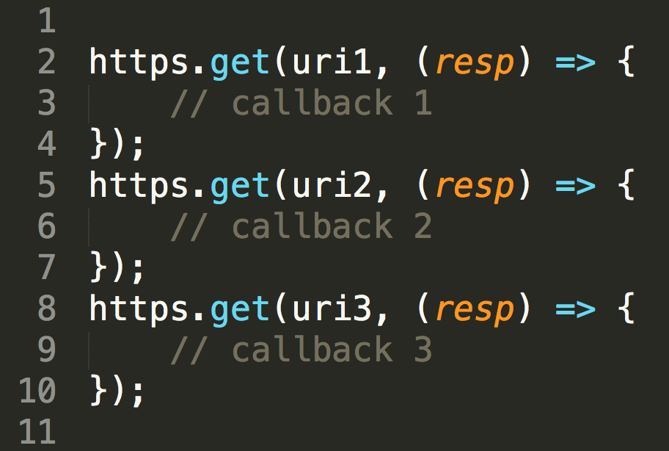
Event Loop - concurrency
Your code
V8 – stack
lib
http.get( )
cb1
http.get( )
cb2
http.get( )
cb3
queue
Many tasks can be launched in pararlell but only one callback can be on the stack at the same time
http.get(cb2)
http.get(cb1)
http.get(cb3)
cb3
cb1
cb2
cb3
main
cb2
cb1

Slide 24
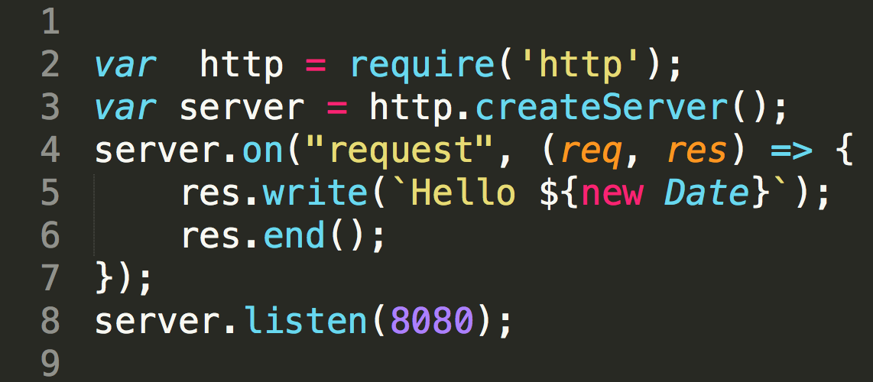
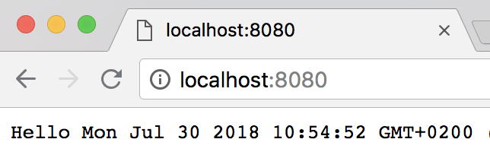
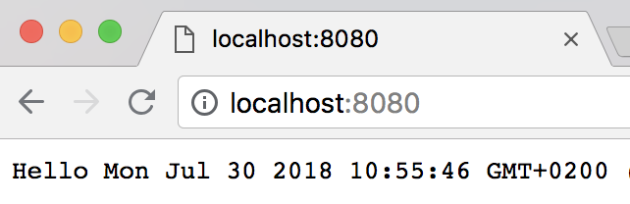
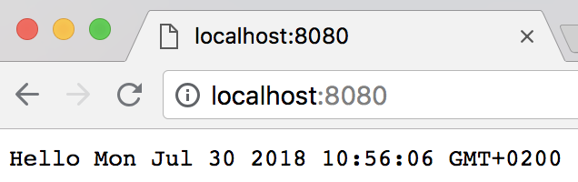
Event Loop – http server
Your code
V8 – stack
lib
listen( )
(req,res)=>{}
queue
(req1,res1)=>{}
(req2,res2)=>{}
(req3,res3)=>{}
listen
(req1,res1)=>{}
(req2,res2)=>{}
(req3,res3)=>{}

Slide 25
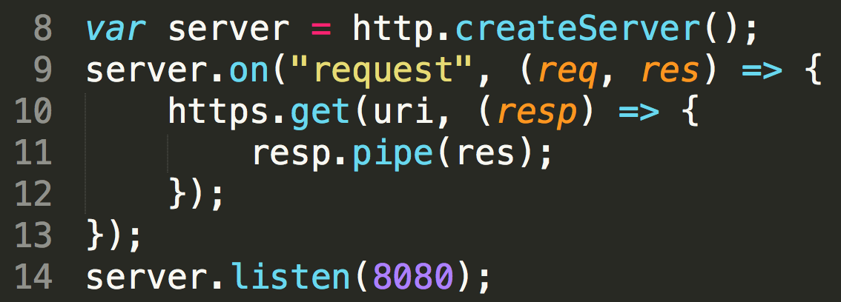
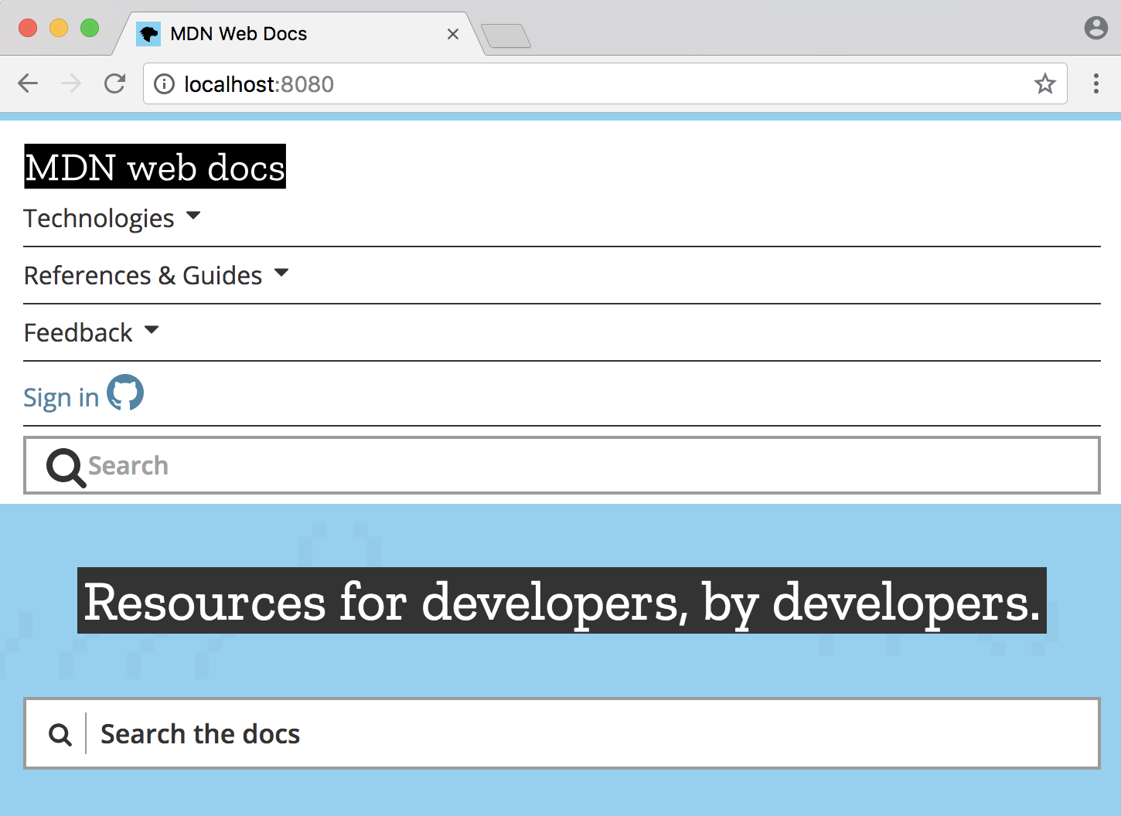
Event Loop – callback code
Your code
V8 – stack
lib
listen( )
(req,res)=>{}
https.get( )
(resp)=>{}
queue
resp.pipe()*
https.get()
Callback codes are usually async as well and create more async jobs resulting as queued items
(req1,res1)=>{}
listen()
(resp)=>{}
(req1,res1)=>{}
(resp)=>{}
* - just to simplify, resp.pipe is actually deeply async as well

Slide 26
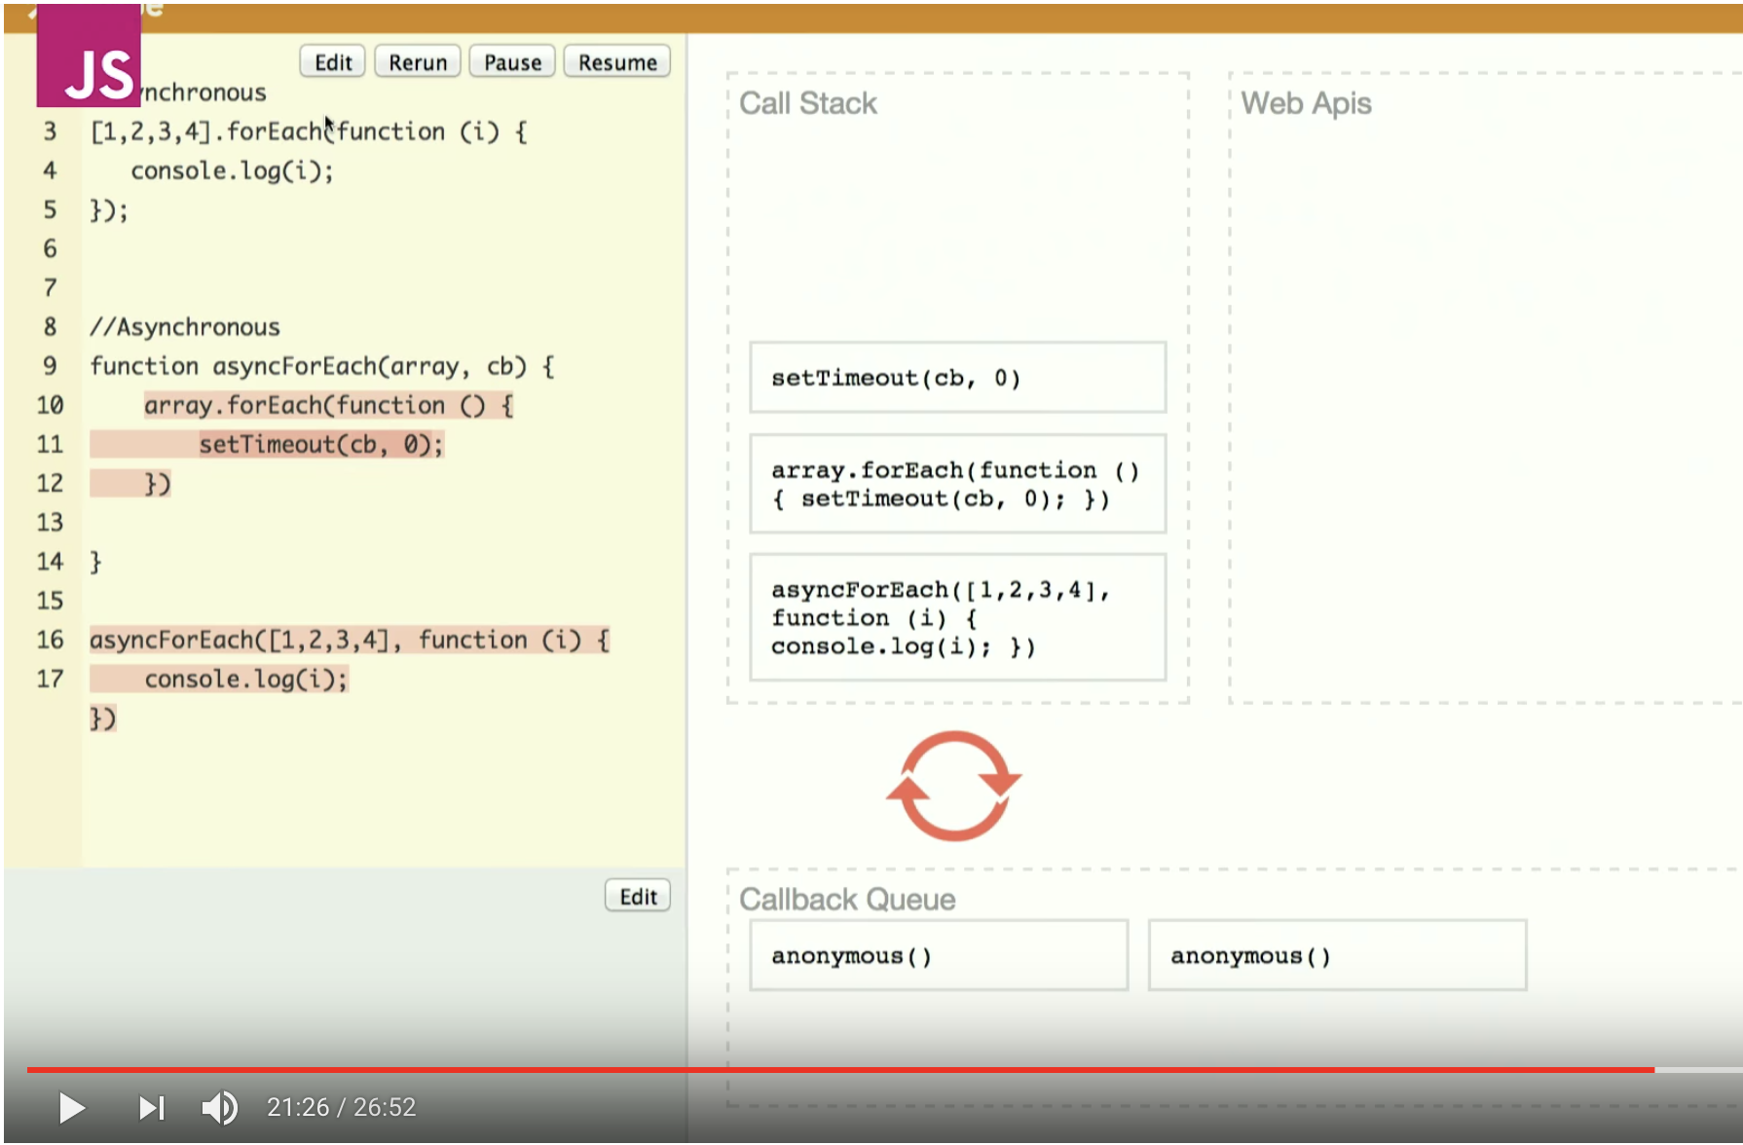
Event Loop and async forEach
https://www.youtube.com/watch?v=8aGhZQkoFbQ

Slide 27
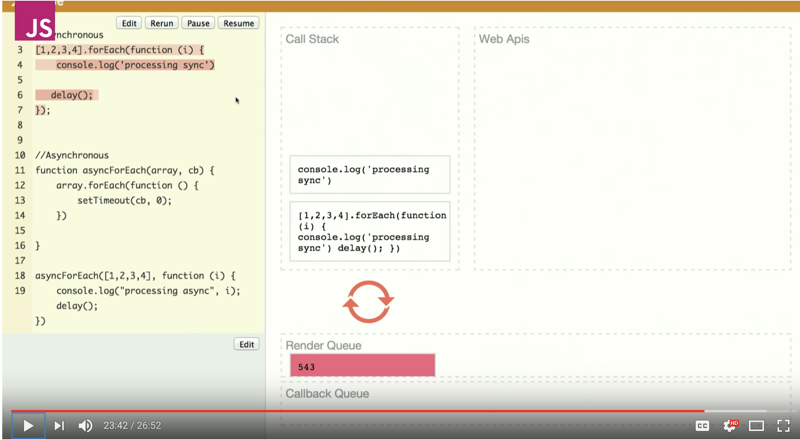
Event Loop and async forEach
sync version
Other tasks (render)
Are blocked for N*delay()
https://www.youtube.com/watch?v=8aGhZQkoFbQ

Slide 28
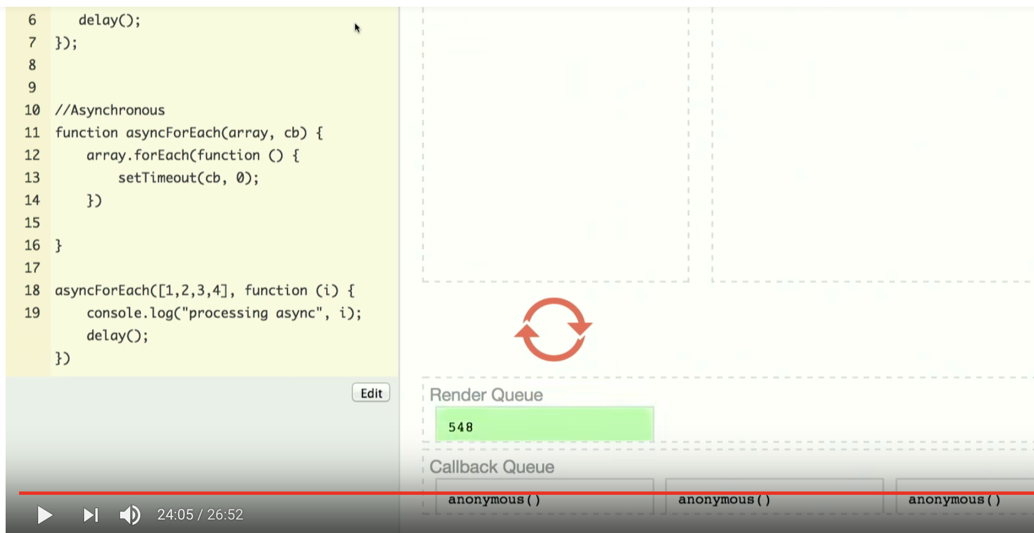
Event Loop and async forEach
async version
Other tasks (render) blocked only for N*queue()
Render has chance to execute between queued callbacks
https://www.youtube.com/watch?v=8aGhZQkoFbQ

Slide 29
Event Loop
lib
V8 – stack
api ( )
api ( )
Event Loop
api ( )
api ( )
queue

